Slide 1
Chapter 21
How to use ADO.NET to write your own data access code

Slide 2
Objectives
Applied
Use a connection to access a SQL Server database.
Use a data reader to retrieve data from a database.
Use data commands to execute action queries or queries that return a scalar value.
Use parameters to limit the data that’s processed by a data command.
Knowledge
Describe the use of parameters with SQL statements.
Describe the use of a data reader.
Describe the use of the two types of queries that don’t return result sets.

Slide 3
.NET data provider core objects
Object Description
Connection Establishes a connection to a database.
Command Represents an individual SQL statement that can be executed against the database.
Data reader Provides read-only, forward-only access to the data in a database.

Slide 4
Three data providers for .NET
Provider Namespace Lets you access…
SQL Server Microsoft.Data.SqlClient SQL Server databases
OLE DB System.Data.OleDb Any database that supports OLE DB
ODBC System.Data.Odbc Any database that supports ODBC

Slide 5
Class names for the data providers
Object SQL Server OLE DB ODBC
Connection SqlConnection OleDbConnection OdbcConnection
Command SqlCommand OleDbCommand OdbcCommand
Data reader SqlDataReader OleDbDataReader OdbcDataReader
A using directive for the SQL Server data provider namespace
using Microsoft.Data.SqlClient;

Slide 6
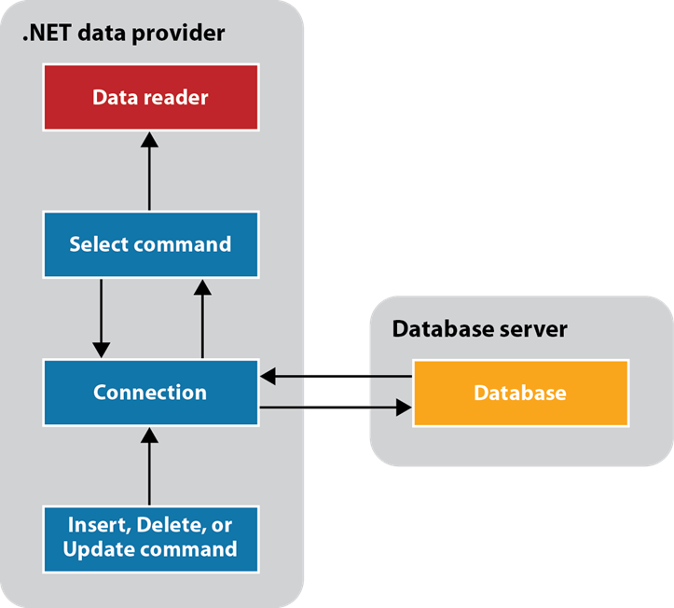
ADO.NET components for accessing a database directly

Slide 7
Two constructors for the SqlConnection class
new SqlConnection()
new SqlConnection(connectionString)
Common property of the SqlConnection class
ConnectionString
Common methods of the SqlConnection class
Open()
Close()

Slide 8
Common values used in the ConnectionString property for SQL Server
Data Source/Server
Initial Catalog/Database
AttachDbFilename
Integrated Security
User ID
Password/Pwd

Slide 9
Two connection strings for the SQL Server provider
For a SQL Server Express LocalDB database
Data Source=(LocalDB)\MSSQLLocalDB;
AttachDbFilename=C:\C#\Database\MMABooks.mdf;
Integrated Security=True
For a SQL Server Express database
Data Source=localhost\SqlExpress;
Initial Catalog=MMABooks;Integrated Security=True

Slide 10
A connection string for the Jet OLE DB provider
Provider=Microsoft.Jet.OLEDB.4.0;
Data Source=C:\C#\Database\MMABooks.mdb

Slide 11
Code that creates, opens, and closes a connection
// get the connection string from the App.config file
string connectionString =
ConfigurationManager.ConnectionStrings["MMABooks"]
.ConnectionString;
// create the connection string and open it
using SqlConnection connection =
new SqlConnection(connectionString);
connection.Open();
// code that uses the connection goes here
// the connection is closed automatically
// when it goes out of scope

Slide 12
Three constructors for the SqlCommand class
new SqlCommand()
new SqlCommand(commandText)
new SqlCommand(commandText, connection)

Slide 13
Common properties of the SqlCommand class
Connection
CommandText
CommandType
Parameters
Common methods of the SqlCommand class
ExecuteReader()
ExecuteNonQuery()
ExecuteScalar()

Slide 14
CommandType enumeration members
Text
StoredProcedure
TableDirect

Slide 15
Code that creates a SqlCommand object that executes a SELECT statement
string select
= "SELECT CustomerID, Name, Address, City, State, ZipCode "
+ "FROM Customers";
using SqlConnection connection =
new SqlConnection(connectionString);
using SqlCommand command = new SqlCommand(select, connection);
connection.Open();
// code that executes the command
// the connection and command are closed
// when they go out of scope

Slide 16
A SQL Server SELECT statement that uses a parameter
SELECT CustomerID, Name, Address, City, State, ZipCode
FROM Customers
WHERE CustomerID = @CustomerID
An OLE DB or ODBC SELECT statement that uses a parameter
SELECT CustomerID, Name, Address, City, State, ZipCode
FROM Customers
WHERE CustomerID = ?
A SQL Server INSERT statement that uses parameters
INSERT INTO Customers
(Name, Address, City, State, ZipCode)
VALUES (@Name, @Address, @City, @State, @ZipCode)

Slide 17
A SQL Server DELETE statement that uses parameters
DELETE FROM Customers
WHERE CustomerID = @CustomerID
AND Name = @Name
AND Address = @Address
AND City = @City
AND State = @State
AND ZipCode = @ZipCode

Slide 18
Four constructors for the SqlParameter class
new SqlParameter()
new SqlParameter(name, value)
new SqlParameter(name, type)
new SqlParameter(name, type, size)
Common properties of the SqlParameter class
ParameterName
Value
Size
DbType
SqlDbType

Slide 19
Code that creates a parameter
SqlParameter customerIDParm = new SqlParameter();
customerIDParm.ParameterName = "@CustomerID";
customerIDParm.Value = customerID;
Another way to create a parameter
SqlParameter customerIDParm =
new SqlParameter("@CustomerID", customerID);

Slide 20
Common indexers of the Parameters collection
[name]
[index]
Common methods of the Parameters collection
Add(parameter)
Add(name, type)
Add(name, type, size)
AddWithValue(name, value)

Slide 21
A statement that adds a parameter to the Parameters collection
selectCommand.Parameters.Add(customerIDParm);
A statement that creates a parameter and adds it to the Parameters collection
selectCommand.Parameters.AddWithValue(
"@CustomerID", customerID);
A statement that changes the value of an existing parameter
selectCommand.Parameters["@CustomerID"].Value =
customerID;

Slide 22
Two ways to create a SqlDataReader object
sqlCommand.ExecuteReader()
sqlCommand.ExecuteReader(behavior)
Common CommandBehavior enumeration members
CloseConnection
Default
SingleRow

Slide 23
Common indexers of the SqlDataReader class
[name]
[index]
Common property of the SqlDataReader class
IsClosed
Common methods of the SqlDataReader class
Close()
Read()

Slide 24
Code that uses a data reader to read a list of State objects
using System.Data;
...
// code that defines the connection and command goes here
List<State> states = new List<State>();
connection.Open();
using SqlDataReader reader =
command.ExecuteReader(
CommandBehavior.CloseConnection);
while (reader.Read())
{
State s = new State {
StateCode = reader["StateCode"].ToString(),
StateName = reader["StateName"].ToString()
}
states.Add(s);
}
// reader closes automatically when it goes out of scope

Slide 25
Code that executes a command that returns a single value
string select = "SELECT SUM(InvoiceTotal) FROM Invoices";
using SqlConnection connection =
new SqlConnection(connectionString);
using SqlCommand command =
new SqlCommand(select, connection);
connection.Open();
decimal invoiceTotal = (decimal) command.ExecuteScalar;

Slide 26
Code that executes a command that inserts a row
string insert = "INSERT Products "
+ "(ProductCode, Description, UnitPrice) "
+ "VALUES (@ProductCode, @Description, @UnitPrice)";
using SqlConnection connection =
new SqlConnection(connectionString));
using SqlCommand command = new SqlCommand(insert, connection);
command.Parameters.AddWithValue("@ProductCode", product.Code);
command.Parameters.AddWithValue("@Description",
product.Description);
command.Parameters.AddWithValue("@UnitPrice", product.Price);
try
{
connection.Open();
int productCount = command.ExecuteNonQuery();
}
catch (SqlException ex)
{
MessageBox.Show(ex.Message);
}

Slide 27
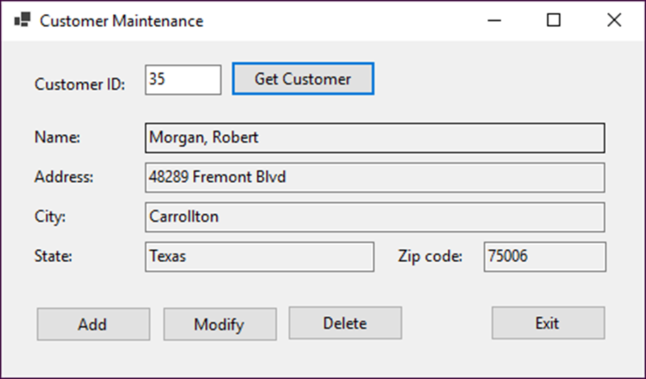
The Customer Maintenance form

Slide 28
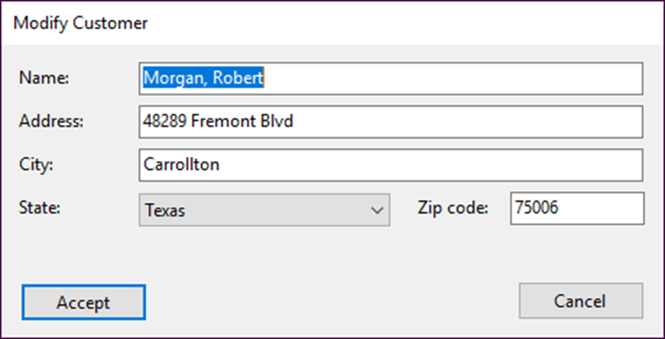
The Add/Modify Customer form

Slide 29
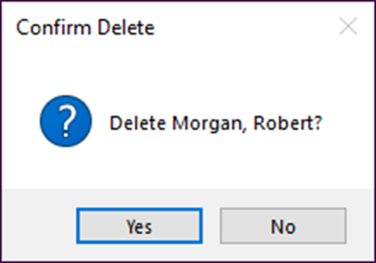
The dialog box for confirming a delete operation

Slide 30
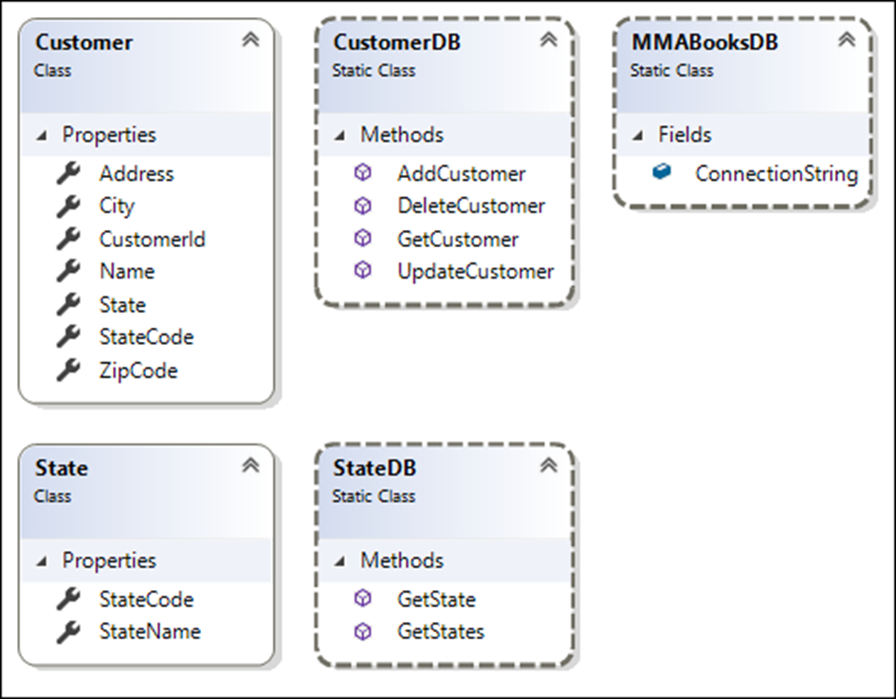
The class diagram

Slide 31
The code for the MMABooksDB class
using System.Configuration;
...
public static class MMABooksDB
{
public static string ConnectionString =>
ConfigurationManager.ConnectionStrings["MMABooks"]
.ConnectionString;
}

Slide 32
The code for the CustomerDB class (part 1)
using System;
using System.Data;
using Microsoft.Data.SqlClient;
...
public static class CustomerDB
{
public static Customer GetCustomer(int customerID)
{
Customer customer = null;
string selectStatement =
"SELECT CustomerID, Name, Address, City, " +
"State, ZipCode " +
"FROM Customers " +
"WHERE CustomerID = @CustomerID";
using SqlConnection connection = new SqlConnection(
MMABooksDB.ConnectionString);
using SqlCommand command = new SqlCommand(
selectStatement, connection);
command.Parameters.AddWithValue("@CustomerID", customerID);
connection.Open();
using SqlDataReader reader =
command.ExecuteReader(CommandBehavior.SingleRow &
CommandBehavior.CloseConnection);

Slide 33
The code for the CustomerDB class (part 2)
if (reader.Read())
{
customer = new Customer {
CustomerId = (int)reader["CustomerID"],
Name = reader["Name"].ToString(),
Address = reader["Address"].ToString(),
City = reader["City"].ToString(),
StateCode = reader["State"].ToString(),
ZipCode = reader["ZipCode"].ToString()
};
}
return customer;
}
public static void AddCustomer(Customer customer)
{
string insertStatement = "INSERT Customers " +
"(Name, Address, City, State, ZipCode) " +
"VALUES (@Name, @Address, @City, @State, @ZipCode)";
using SqlConnection connection = new SqlConnection(
MMABooksDB.ConnectionString);
using SqlCommand command = new SqlCommand(
insertStatement, connection);

Slide 34
The code for the CustomerDB class (part 3)
command.Parameters.AddWithValue("@Name", customer.Name);
command.Parameters.AddWithValue(
"@Address", customer.Address);
command.Parameters.AddWithValue("@City", customer.City);
command.Parameters.AddWithValue(
"@State", customer.StateCode);
command.Parameters.AddWithValue(
"@ZipCode", customer.ZipCode);
connection.Open();
int count = command.ExecuteNonQuery();
if (count > 0) {
command.CommandText =
"SELECT IDENT_CURRENT('Customers') " +
"FROM Customers";
customer.CustomerId =
Convert.ToInt32(command.ExecuteScalar());
}
}

Slide 35
The code for the CustomerDB class (part 4)
public static bool UpdateCustomer(Customer oldCustomer,
Customer newCustomer)
{
string updateStatement =
"UPDATE Customers SET " +
"Name = @NewName, " +
"Address = @NewAddress, " +
"City = @NewCity, " +
"State = @NewState, " +
"ZipCode = @NewZipCode " +
"WHERE CustomerID = @oldCustomerID " +
"AND Name = @OldName " +
"AND Address = @OldAddress " +
"AND City = @OldCity " +
"AND State = @OldState " +
"AND ZipCode = @OldZipCode";
using SqlConnection connection =
new SqlConnection(MMABooksDB.ConnectionString);
using SqlCommand command =
new SqlCommand(updateStatement, connection);
command.Parameters.AddWithValue(
"@NewName", newCustomer.Name);
command.Parameters.AddWithValue(
"@NewAddress", newCustomer.Address);

Slide 36
The code for the CustomerDB class (part 5)
command.Parameters.AddWithValue(
"@NewCity", newCustomer.City);
command.Parameters.AddWithValue(
"@NewState", newCustomer.StateCode);
command.Parameters.AddWithValue(
"@NewZipCode", newCustomer.ZipCode);
command.Parameters.AddWithValue(
"@OldCustomerID", oldCustomer.CustomerId);
command.Parameters.AddWithValue(
"@OldName", oldCustomer.Name);
command.Parameters.AddWithValue(
"@OldAddress", oldCustomer.Address);
command.Parameters.AddWithValue(
"@OldCity", oldCustomer.City);
command.Parameters.AddWithValue(
"@OldState", oldCustomer.StateCode);
command.Parameters.AddWithValue(
"@OldZipCode", oldCustomer.ZipCode);
connection.Open();
int count = command.ExecuteNonQuery();
return (count > 0);
}

Slide 37
The code for the CustomerDB class (part 6)
public static bool DeleteCustomer(Customer customer)
{
string deleteStatement =
"DELETE FROM Customers " +
"WHERE CustomerID = @CustomerID " +
"AND Name = @Name " +
"AND Address = @Address " +
"AND City = @City " +
"AND State = @State " +
"AND ZipCode = @ZipCode";
using SqlConnection connection =
new SqlConnection(MMABooksDB.ConnectionString);
using SqlCommand command =
new SqlCommand(deleteStatement, connection);
command.Parameters.AddWithValue(
"@CustomerID", customer.CustomerId);
command.Parameters.AddWithValue("@Name", customer.Name);
command.Parameters.AddWithValue(
"@Address", customer.Address);
command.Parameters.AddWithValue("@City", customer.City);
command.Parameters.AddWithValue(
"@State", customer.StateCode);
command.Parameters.AddWithValue(
"@ZipCode", customer.ZipCode);

Slide 38
The code for the CustomerDB class (part 7)
connection.Open();
int count = command.ExecuteNonQuery();
return (count > 0);
}
}

Slide 39
The code for the StateDB class (part 1)
using System.Collections.Generic;
using System.Data;
using Microsoft.Data.SqlClient;
...
public static class StateDB
{
public static List<State> GetStates()
{
List<State> states = new List<State>();
string selectStatement = "SELECT StateCode, StateName "
+ "FROM States "
+ "ORDER BY StateName";
using SqlConnection connection = new SqlConnection(
MMABooksDB.ConnectionString);
using SqlCommand command = new SqlCommand(
selectStatement, connection);
connection.Open();
using SqlDataReader reader = command.ExecuteReader(
CommandBehavior.CloseConnection);

Slide 40
The code for the StateDB class (part 2)
while (reader.Read())
{
State s = new State {
StateCode = reader["StateCode"].ToString(),
StateName = reader["StateName"].ToString()
};
states.Add(s);
}
return states;
}
public static State GetState(string stateCode)
{
State state = null; // default return value
string selectStatement = "SELECT StateCode, StateName "
+ "FROM States "
+ "WHERE StateCode = @StateCode";
using SqlConnection connection = new SqlConnection(
MMABooksDB.ConnectionString);
using SqlCommand command = new SqlCommand(
selectStatement, connection);
command.Parameters.AddWithValue("@StateCode", stateCode);

Slide 41
The code for the StateDB class (part 3)
connection.Open();
using SqlDataReader reader =
command.ExecuteReader(CommandBehavior.SingleRow &
CommandBehavior.CloseConnection);
if (reader.Read())
{
state = new State {
StateCode = reader["StateCode"].ToString(),
StateName = reader["StateName"].ToString()
};
}
return state;
}
}

Slide 42
Code for the Customer Maintenance form (part 1)
using System;
using System.Windows.Forms;
using CustomerMaintenance.Models.DataLayer;
using Microsoft.Data.SqlClient;
...
public partial class frmCustomerMaintenance : Form
{
...
private Customer customer;
private void btnGetCustomer_Click(object sender, EventArgs e)
{
if (IsValidData())
{
int customerID = Convert.ToInt32(txtCustomerID.Text);
try
{
this.GetCustomer(customerID);
if (customer == null) {
MessageBox.Show("No customer found with this ID. " +
"Please try again.", "Customer Not Found");
this.ClearControls();
}
else {
this.DisplayCustomer();
}
}

Slide 43
Code for the Customer Maintenance form (part 2)
catch (SqlException ex)
{
this.HandleDatabaseError(ex);
}
catch (Exception ex)
{
this.HandleGeneralError(ex);
}
}
}
private bool IsValidData()
{
bool success = true;
string errorMessage = "";
errorMessage = Validator.IsInt32(
txtCustomerID.Text, txtCustomerID.Tag.ToString());
if (errorMessage != "")
{
success = false;
MessageBox.Show(errorMessage, "Entry Error");
txtCustomerID.Focus();
}
return success;
}

Slide 44
Code for the Customer Maintenance form (part 3)
private void GetCustomer(int customerId)
{
customer = CustomerDB.GetCustomer(customerId);
this.GetState();
}
private void GetState()
{
if (customer != null)
{
customer.State = StateDB.GetState(customer.StateCode);
}
}
private void DisplayCustomer()
{
// same as in chapter 20
}
private void ClearControls()
{
// same as in chapter 20
}

Slide 45
Code for the Customer Maintenance form (part 4)
private void btnAdd_Click(object sender, EventArgs e)
{
var addModifyForm = new frmAddModifyCustomer {
AddCustomer = true,
States = StateDB.GetStates()
};
DialogResult result = addModifyForm.ShowDialog();
if (result == DialogResult.OK)
{
customer = addModifyForm.Customer;
try
{
CustomerDB.AddCustomer(customer);
this.GetState();
this.DisplayCustomer();
}
catch (SqlException ex)
{
this.HandleDatabaseError(ex);
}
catch (Exception ex)
{
this.HandleGeneralError(ex);
}
}
}

Slide 46
Code for the Customer Maintenance form (part 5)
private void btnModify_Click(object sender, EventArgs e)
{
Customer oldCustomer = this.CloneCustomer(); // save old values
var addModifyForm = new frmAddModifyCustomer {
AddCustomer = false,
Customer = customer,
States = StateDB.GetStates()
};
DialogResult result = addModifyForm.ShowDialog();
if (result == DialogResult.OK)
{
customer = addModifyForm.Customer; // get new values
try
{
if (CustomerDB.UpdateCustomer(oldCustomer, customer))
{
this.GetState();
this.DisplayCustomer();
}
else
{
this.HandleConcurrencyConflict();
}
}

Slide 47
Code for the Customer Maintenance form (part 6)
catch (SqlException ex)
{
this.HandleDatabaseError(ex);
}
catch (Exception ex)
{
this.HandleGeneralError(ex);
}
}
}
private Customer CloneCustomer()
{
return new Customer
{
CustomerId = customer.CustomerId,
Name = customer.Name,
Address = customer.Address,
City = customer.City,
StateCode = customer.StateCode,
ZipCode = customer.ZipCode,
State = customer.State
};
}

Slide 48
Code for the Customer Maintenance form (part 7)
private void btnDelete_Click(object sender, EventArgs e)
{
DialogResult result =
MessageBox.Show($"Delete {customer.Name}?", "Confirm Delete",
MessageBoxButtons.YesNo, MessageBoxIcon.Question);
if (result == DialogResult.Yes)
{
try
{
if (CustomerDB.DeleteCustomer(customer))
{
this.ClearControls();
}
else
{
this.HandleConcurrencyConflict();
}
}
catch (SqlException ex)
{
this.HandleDatabaseError(ex);
}
catch (Exception ex)
{
this.HandleGeneralError(ex);
}
}
}

Slide 49
Code for the Customer Maintenance form (part 8)
private void HandleConcurrencyConflict()
{
this.GetCustomer(customer.CustomerId); // reload customer
if (customer == null) {
MessageBox.Show("Another user has deleted that customer.",
"Concurrency Error");
this.ClearControls();
}
else {
string message = "Another user has updated that customer.\n" +
"The current database values will be displayed.";
MessageBox.Show(message, "Concurrency Error");
this.DisplayCustomer();
}
}
private void HandleDatabaseError(SqlException ex)
{
// in real life, would do something with error like log it
MessageBox.Show(ex.Message, ex.GetType().ToString());
}
private void HandleGeneralError(Exception ex)
{
MessageBox.Show(ex.Message, ex.GetType().ToString());
}
}

Slide 50
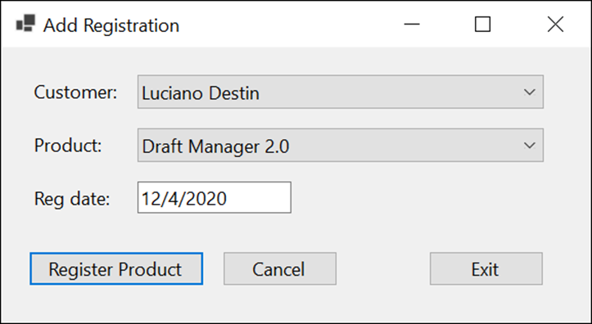
Project 5-2 Register products (part 1)
Develop an application that lets the user register products to customers.

Slide 51
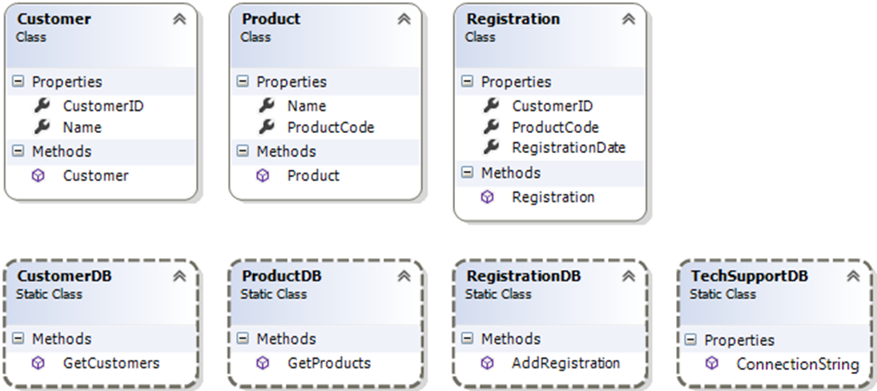
Project 5-2 Register products (part 2)
Add the classes shown above to the project.

Slide 52
Objectives
Applied
Use a connection to access a SQL Server database.
Use a data reader to retrieve data from a database.
Use data commands to execute action queries or queries that return a scalar value.
Use parameters to limit the data that’s processed by a data command.
Knowledge
Describe the use of parameters with SQL statements.
Describe the use of a data reader.
Describe the use of the two types of queries that don’t return result sets.

